Slide 1
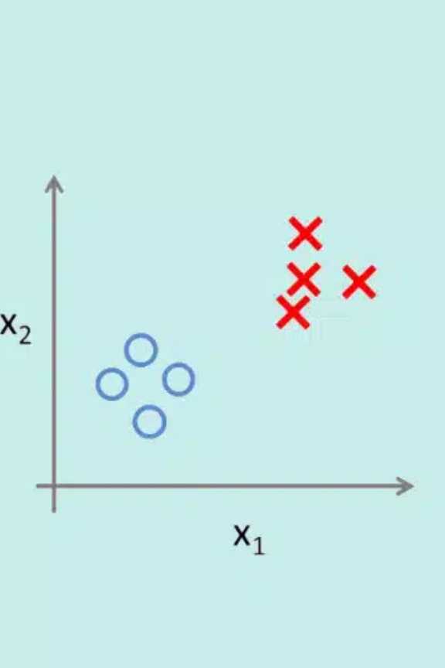
Supervised Learning- Classification
Today’s Agenda
What is Classification?
Types of Classification Problems
Logistic Regression – Intuition
Sigmoid Function & Decision Boundary
Loss Function (Binary Cross-Entropy)
Evaluation Metrics for Classification
Hands-On Practice
Kahoot(Quiz)

Slide 2
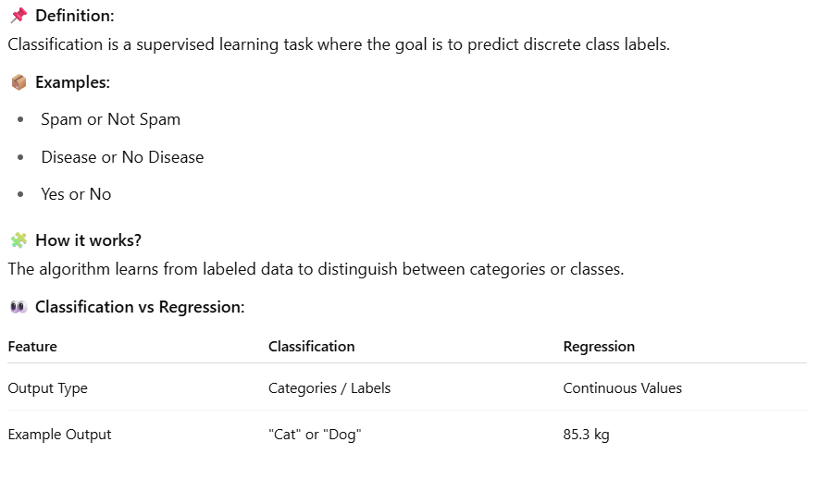
What is Classification?
Difference between clustering and classification
Clustering is unsupervised whereas classification is supervised

Slide 3
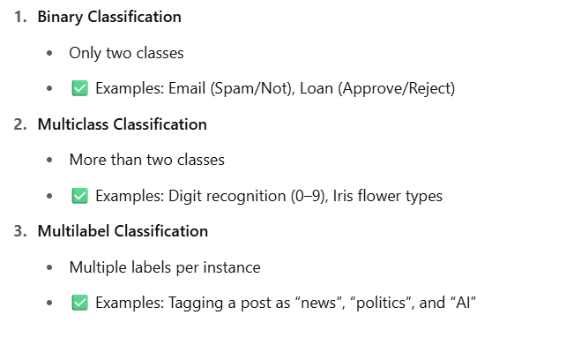
Types of Classification Problems

Slide 4
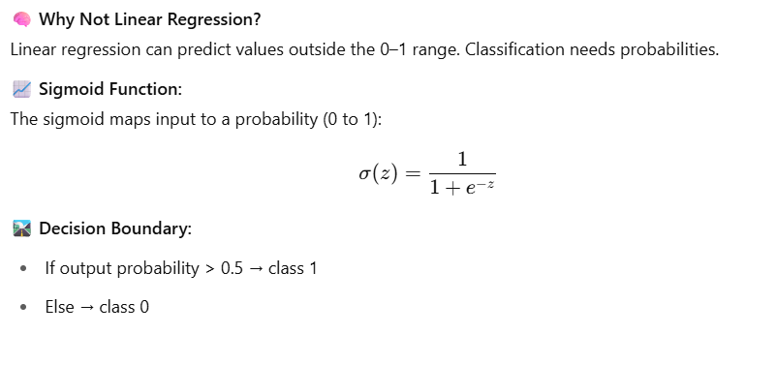
Logistic Regression – Intuition

Slide 5
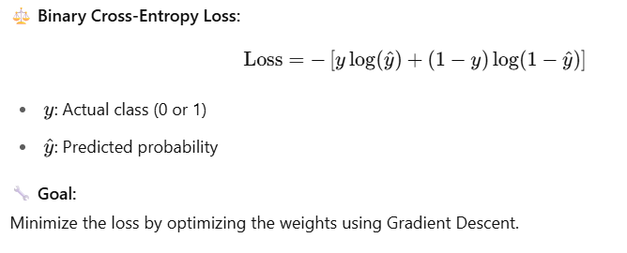
Loss Function & Optimization
Loss lai minimize garne or optimize garne lai loss function bhanxa

Slide 6
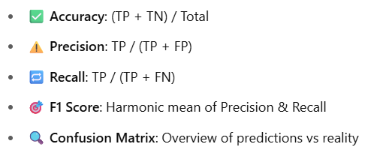
Evaluation Metrics

